Slide 1
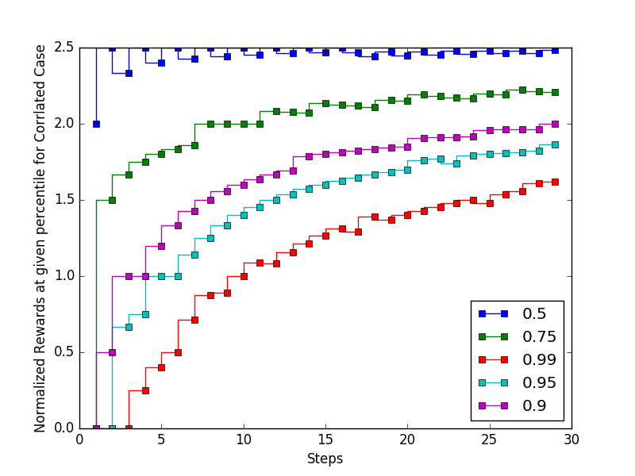
Normalized reward for varying acceptable error rates
# Time slots (deadline)

